Slide 1
Data Mining Project

Slide 2

Agenda
Introduction
Model Training
Front-end
Accuracy

Slide 3

Introduction

Slide 4
Project:
Our project aims to develop a comprehensive forecasting system across multiple sectors.
We utilize data sources including sectors.
Cleaning and preprocessing ensure data quality and suitability for modeling.
Python with Flask powers our backend logic and API handling FRONT-END
DIFFERENT MODELS SUCH AS ARIMA,ANN ,SARIMA ,ETS, PROPHET ,LSTM, HYBRIND
USED THESE TO MAKE PREDICTION
FLASK FOR PEDICTION ANS VISUALIZATION

Slide 5

DATASET :
The dataset we chose for the project is energy consumption in America.
energy_consumption.csv
It contains two columns:
datetime (ds) and consumption (y).
Datetime is in hours.

Slide 6

Model Training
Predictions

Slide 7
ARIMA : ANN:
ARIMA is a popular time series forecasting method that models the relationship between the current observation and a linear combination of lagged observations and the errors at prior time points.
It's suitable for time series data that exhibit levels of non-stationarity or seasonal patterns.
ARIMA involves parameters for autoregression (p), differencing (d), and moving average (q).
ANN is a machine learning model inspired by the structure and function of the human brain's neural networks.
It consists of interconnected nodes (neurons) organized in layers: an input layer, one or more hidden layers, and an output layer.
ANN models learn complex patterns and relationships in data by adjusting the weights of connections between neurons during training.
They are capable of handling non-linear relationships and are particularly effective for tasks such as classification, regression, and time series forecasting.

Slide 8
Seasonal ARIMA: ETS:
SARIMA is an extension of ARIMA that includes seasonality components.
It incorporates seasonal differencing (D) and seasonal autoregression (P), differencing (d), and autoregression (p) like ARIMA.
SARIMA is suitable for data with both trend and seasonality that change over time.
ETS methods forecast future values by assigning exponentially decreasing weights to past observations.
ETS models are particularly useful for data with a trend or seasonality that changes over time.
It can handle various components like level, trend, and seasonality, allowing for flexible modeling of different time series patterns.

Slide 9
Support Vector Regression (SVR):
SVR is a supervised learning algorithm that performs regression tasks by mapping input data into a higher-dimensional feature space.
It works by finding the hyperplane that best separates the data points while maximizing the margin.
SVR is effective for datasets with complex relationships and can handle non-linear data effectively through the use of kernel functions.

Slide 10
Long Short-Term Memory (LSTM):
LSTM is a type of recurrent neural network (RNN) architecture that is well-suited for processing and making predictions based on sequences of data.
It can capture long-term dependencies in sequential data, making it suitable for time series forecasting tasks.
LSTM networks include memory cells that can maintain information over extended time periods, allowing them to learn and predict patterns in time series data effectively.

Slide 11
Hybrid Models Integration:
Hybrid models integrate multiple forecasting techniques to improve prediction accuracy by leveraging the strengths of each individual model.
Combining models like polynomial regression and LSTM can result in better forecasts by capturing different aspects of the data.
Hybrid models offer flexibility and robustness, allowing for more accurate predictions in complex time series datasets.

Slide 12

FRONT-END
User interface

Slide 13
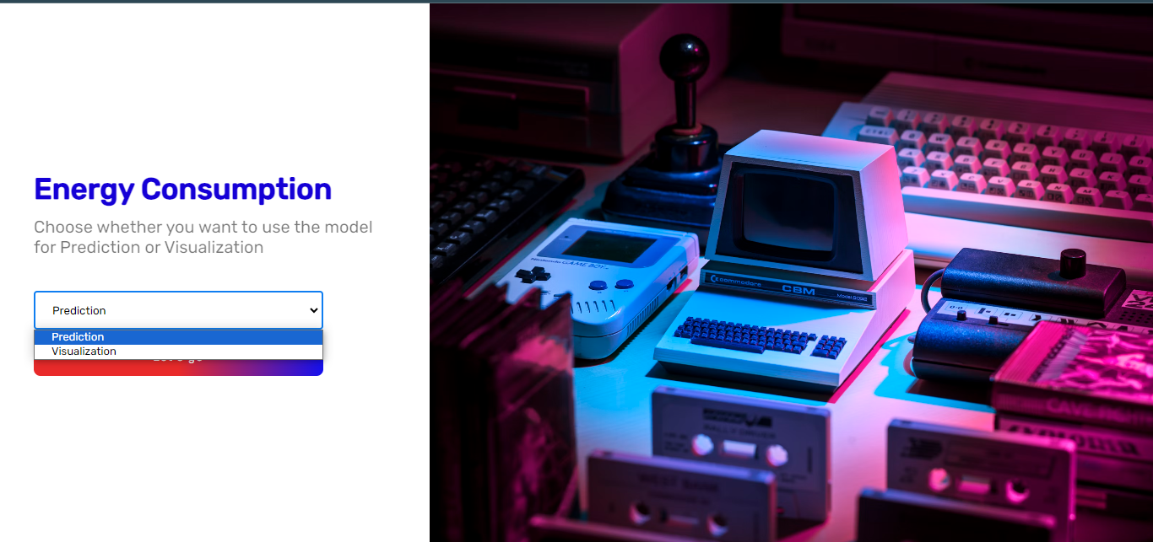
Home Page :
Asks user what they want to do .

Slide 14
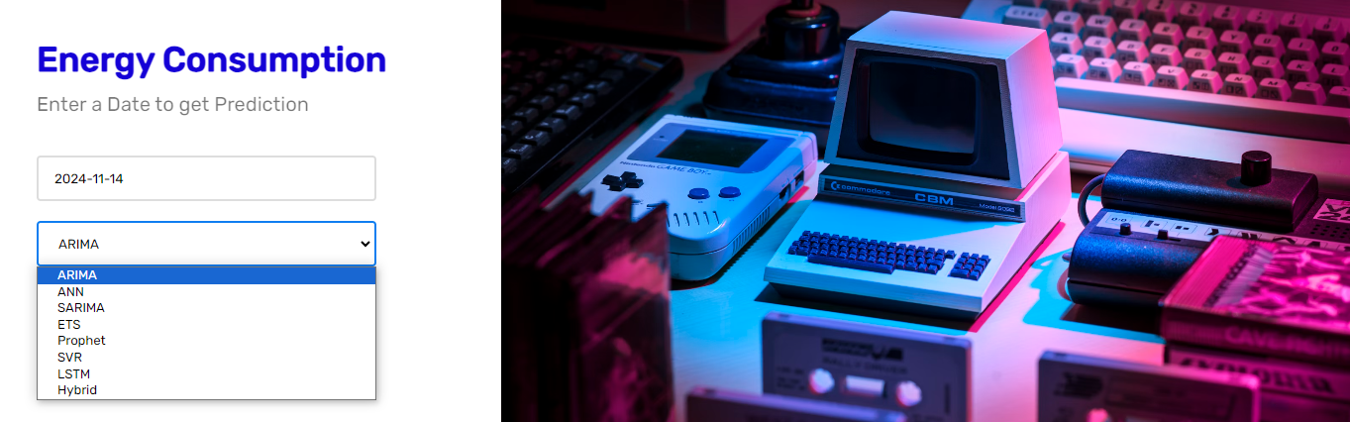
Input Page : (For Prediction)
Ask user to enter date and choose mode for prediction.

Slide 15
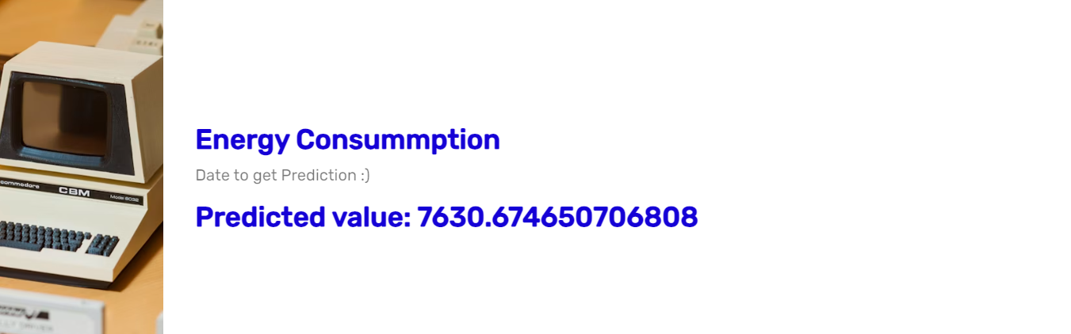
Output Page :
Shows output of the predictions .

Slide 16
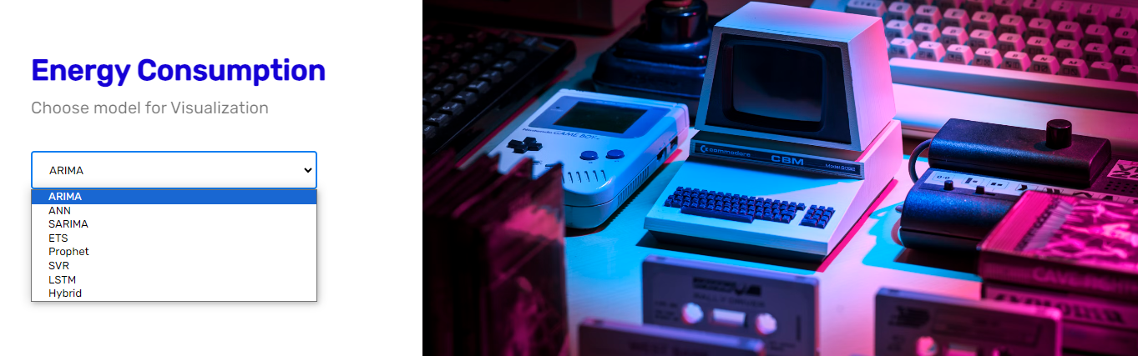
Visual Page (For Visualization)
Ask user for the models for visualization.

Slide 17
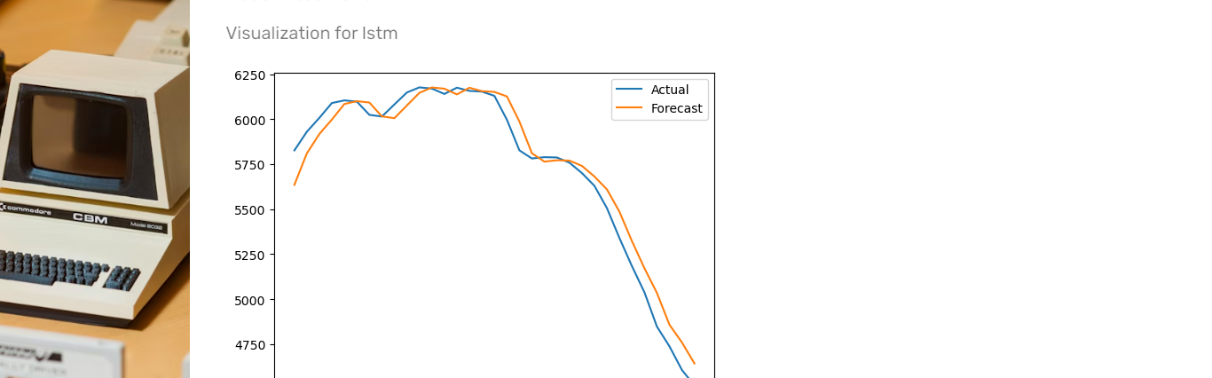
Show Page :
Shows visualization of the selected model.

Slide 18

Accuracy :

Slide 19
Accuracy :
Models | Measurement | Value
ARIMA | Accuracy | 92.0388952148133
2. ANN | Accuracy | 91.0625527598262
SARIMA | Accuracy | 86.8576800708499
4. ETS | Accuracy | 87.0614293875295
5. SVR | Accuracy | 94.3321788961516
6. LSTM | Accuracy | 93.0646268381966
7. Hybrid | Accuracy | 95.5701158956781

